Slide 1





Capturing temporal evolution and distribution in LCA
Arthur Jakobs, Timo Diepers, Amelie Müller

Slide 2
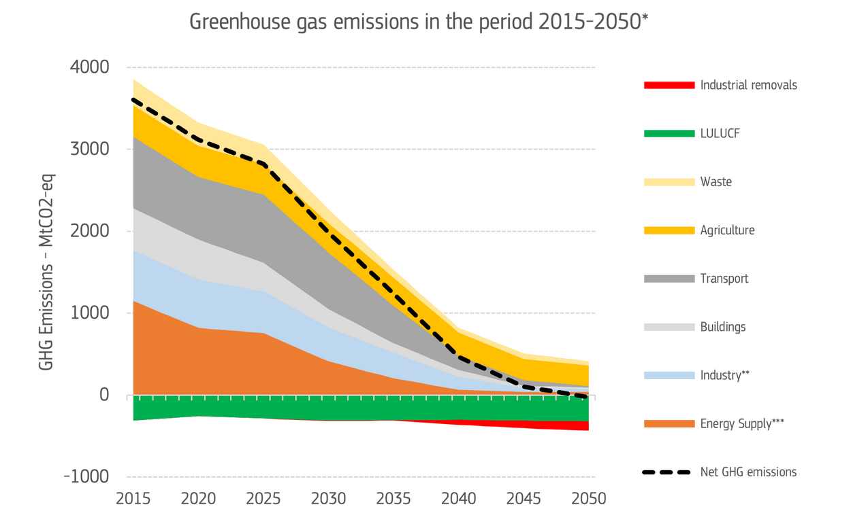
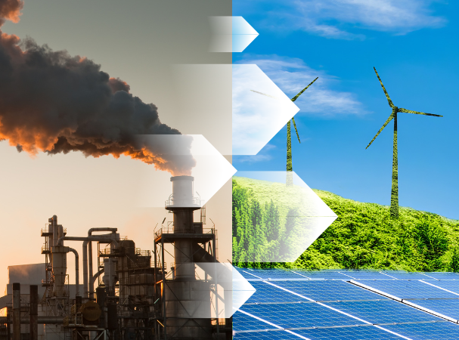
Climate change mitigation requires rapid action in all industries
https://mcsolutions.vn/wp-content/uploads/2024/07/Energy-Transition-.png
https://climate.ec.europa.eu/eu-action/climate-strategies-targets/2040-climate-target_en

Slide 3
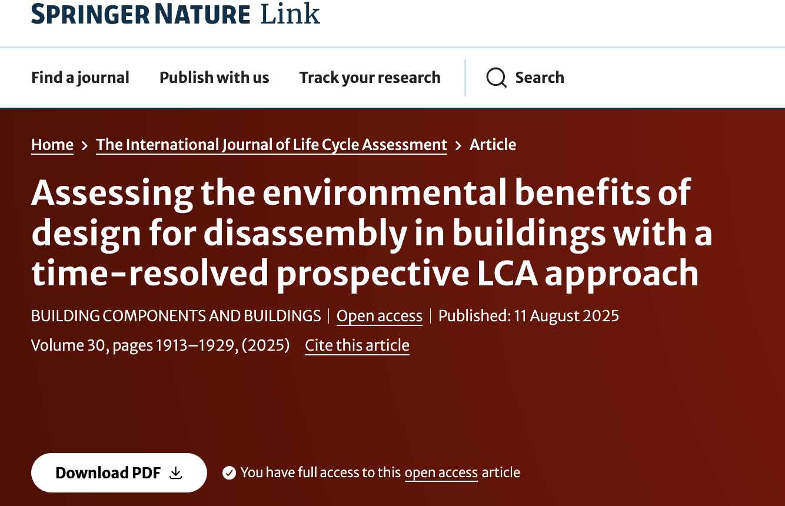
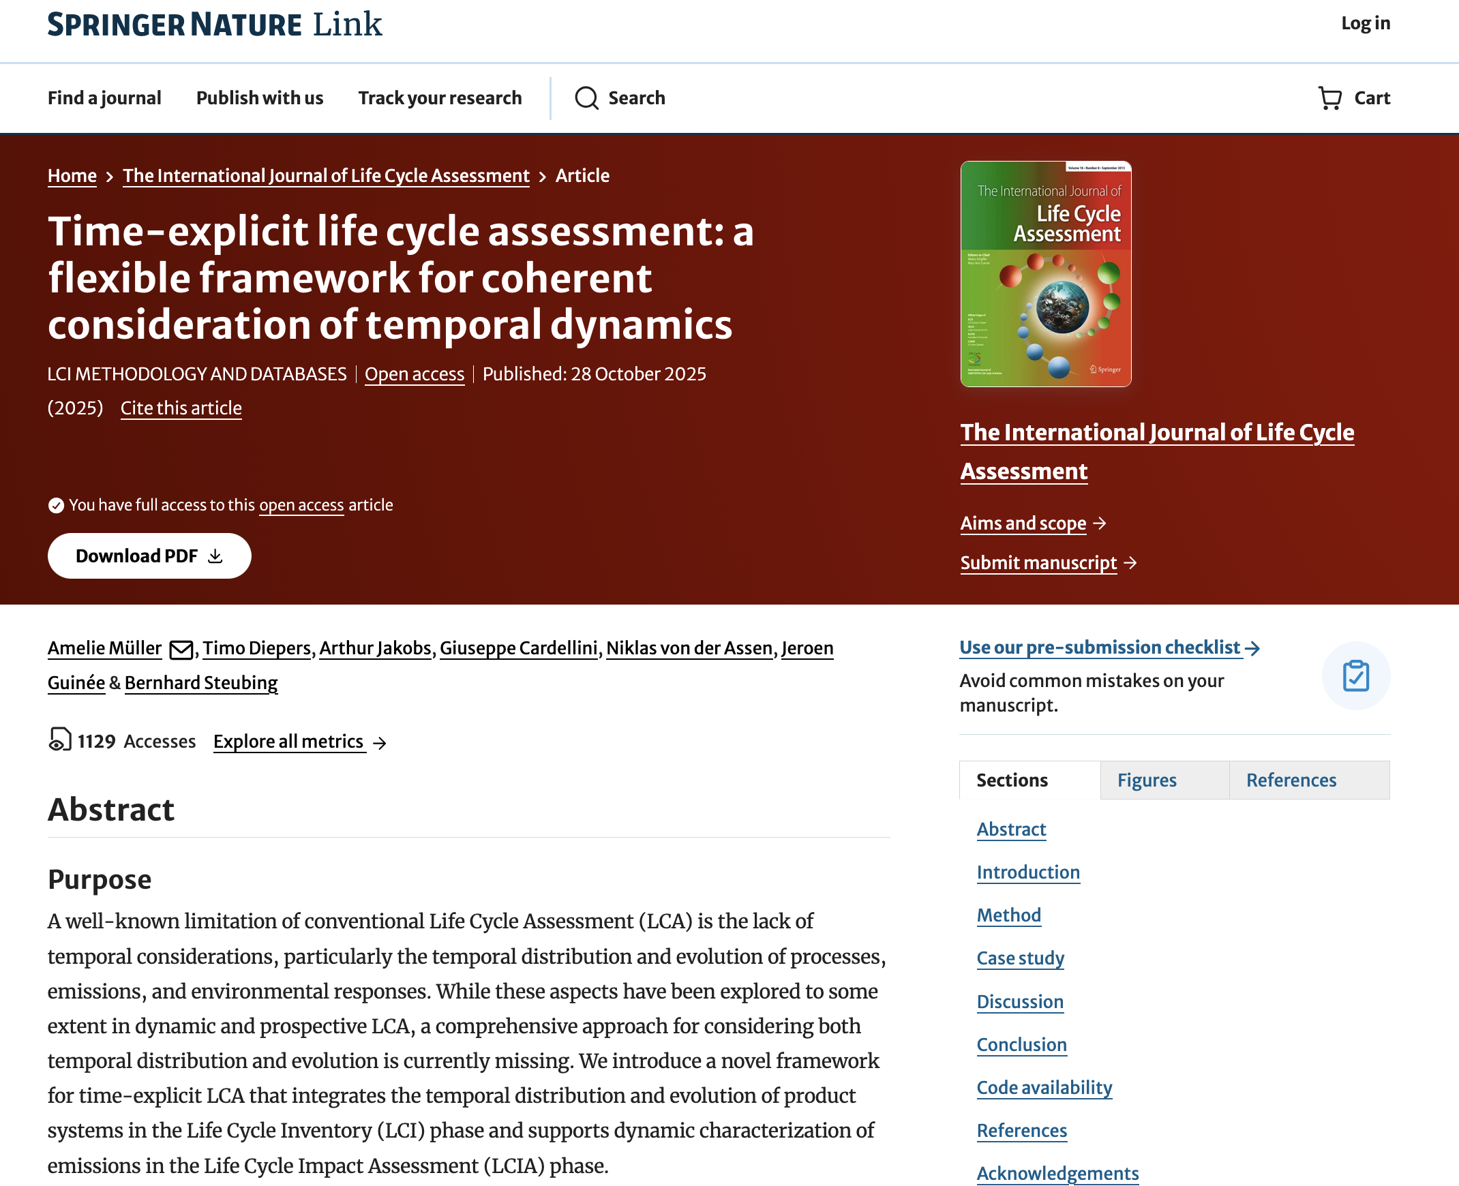
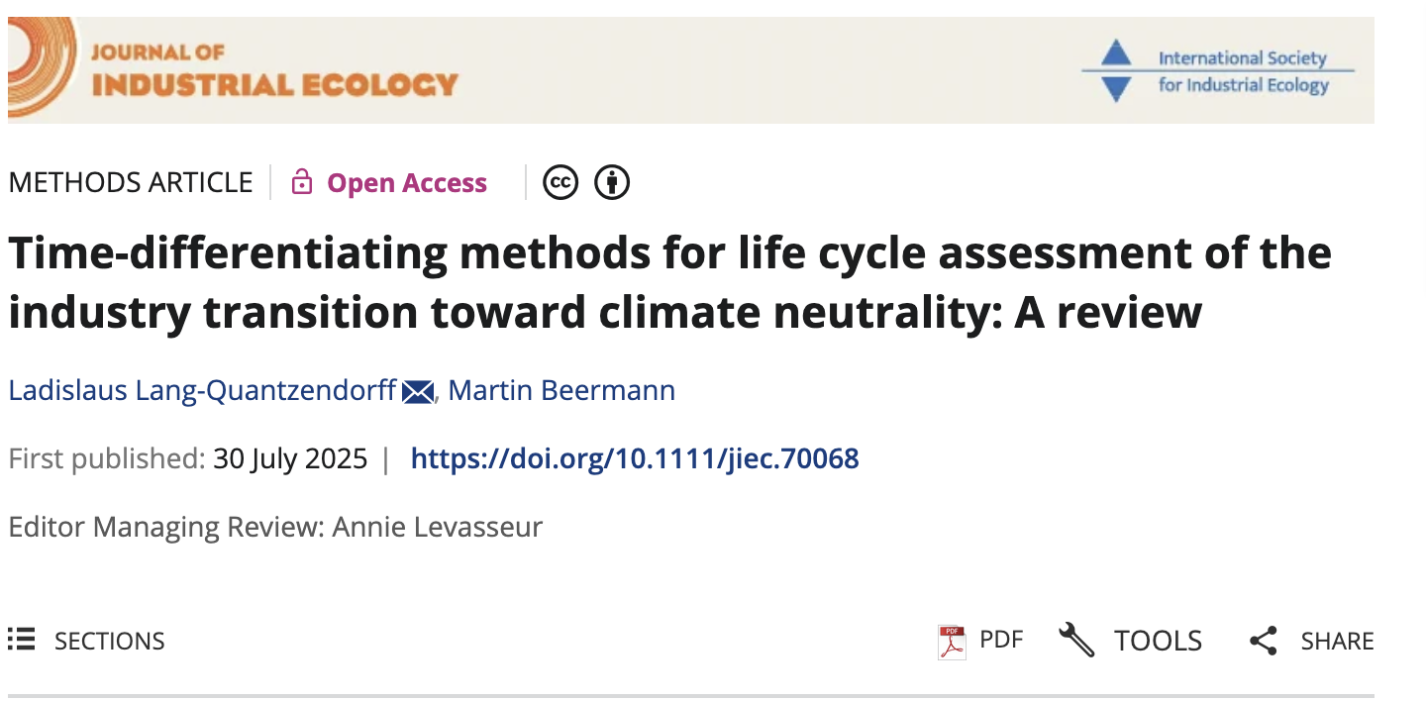
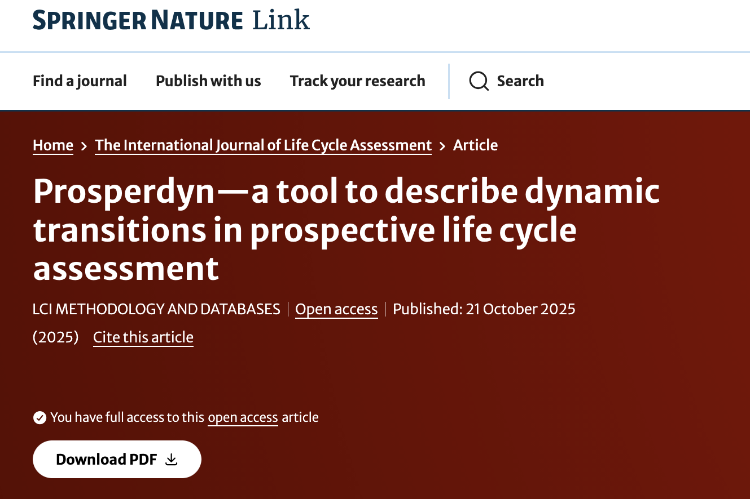
Temporal representation of time in LCA trending…
→ bw_timex:

Slide 4








Life cycle of an electric vehicle
use
construction
end of life

Slide 5
‘Conventional’ LCA: “system today”
database:
2020
Conventional
LCA
use
2020
EoL
Use
GWP₁₀₀
Constr.
construction
end of life
2020
2020

Slide 6



Temporal Evolution: “prospective state of the system”
databases:
2020
2025
2030
2035
2040
Conventional
LCA
use
Prospective
LCA
2040
EoL
Use
GWP₁₀₀
Evolving production system
EoL
Use
Constr.
Constr.
construction
end of life
2040
2040
2020
2025
2030
2035
2040

Slide 7
Temporal distribution: “the system over time”
databases:
2020
2025
2030
2035
2040
‘Dynamic’
LCA
use
2025-2035
EoL
EoL
Use
Use
Dynamic impact assessment
e.g. GWP_{dynamic}
+
Use
GWP₁₀₀
EoL
Use
Use
Constr.
Constr.
construction
2020
end of life
2040
2020
2025
2030
2035
2040

Slide 8



Time-explicit LCA: “Temporal distribution + evolution”
databases:
2020
2025
2030
2035
2040
2030
2035
EoL
2025
Use
EoL
Use
GWP₁₀₀
Use
EoL
Use
Use
Constr.
Constr.
construction
2020
end of life
2040
2020
2025
2030
2035
2040

Slide 9


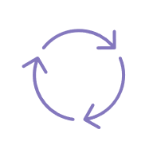
Time-explicit LCA: “Temporal distribution + evolution”
databases:
2035
2010
1990
2050
2020
2025
2030
2035
2040
2030
2035
2030
2030
EoL
2025
Use
EoL
Use
GWP₁₀₀
Use
EoL
Use
Use
2020
2040
2055
2010
Constr.
Constr.
2025
2030
2020
2025
2030
2035
2040

Slide 10

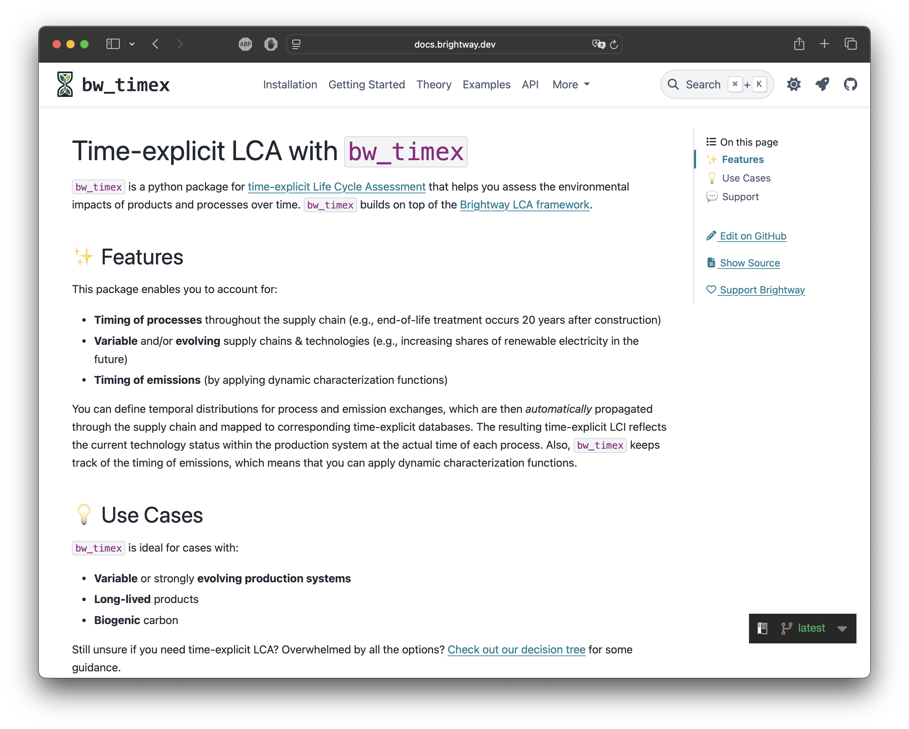

- managing time for you
bw_timex enables you to account for
Timing of processes
Timing of emissions
Evolving supply chains
While:
Working with your favourite LCA software…
Doing the hard work for you
Providing extensive documentation

Slide 11
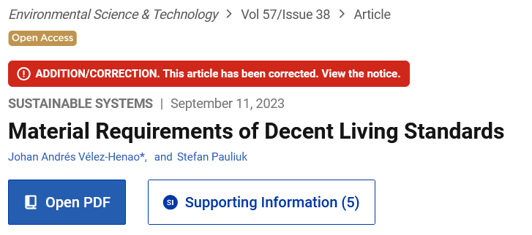
- link to MFA
temporally distributed supply chains:
timeline shows inflows and outflows
→ easy integration with dMFA
bw_timex.tlca.timeline
Time of producing process | Producing process | Time of consuming process | Consuming process | Intermediate product | Amount | Temporal market shares
2021-01-01 | C | 2023-01-01 | B | c | 0.9 | 2020: 0.9, 2030: 0.1
2023-01-01 | B | 2024-01-01 | A | b | 2.0 | –
2024-01-01 | A | 2024-01-01 | -1 (FU) | a | 1.0 | –
2028-01-01 | C | 2023-01-01 | B | c | 2.1 | 2020: 0.2, 2030: 0.8
Inflows (C -> B)
Outflows (B -> A)
New school of MFA: Material demand for decent living standards
→ close to LCA perspective (outflow driven instead of inflow or stock driven)
https://pubs.acs.org/doi/10.1021/acs.est.3c03957

Slide 12
Time to get started…
Open the jupyter notebook on:
https://github.com/Depart-de-Sentier/Schools-2025-November-Switzerland/tree/main/Notebooks/bw_timex:
→ dds_autumnschool_example_electric_vehicle_standalone.ipynb

Slide 13

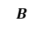


How does it work: A-B-C example
1) Flowchart of A-B-C example
2) Original matrices
process B
process A
process C
$$A$$
product a
1
0
0
4) Time-explicit matrices
product b
-2
1
0
process C @ 2020
process C @ 2030
process B @ 2023
product c
0
-3
1
process A @ 2024
TM c @ 2028
$$A^{∗}$$
TM c @ 2021
$$B$$
CO₂
5
1
11
product a @ 2024
1
0
0
0
0
0
product b @ 2023
-2
1
0
0
0
0
3) Timeline of intermediate flows
product c @ 2020
0
0
1
0
-0.9
-0.2
Time of producing process | Producing process | Time of consuming process | Consum-ing process | Intermediate product | Amount | Temporal market shares
2021-01-01 | C | 2023-01-01 | B | c | 0.9 | 2020: 0.9, 2030: 0.1
2023-01-01 | B | 2024-01-01 | A | b | 2.0 | –
2024-01-01 | A | 2024-01-01 | -1 (FU) | a | 1.0 | –
2028-01-01 | C | 2023-01-01 | B | c | 2.1 | 2020: 0.2, 2030: 0.8
product c @ 2030
0
0
0
1
-0.1
-0.8
product c @ 2021
0
-0.9
0
0
1
0
product c @ 2028
0
-2.1
0
0
0
1
$$B^{∗ }$$
CO₂ @ 2021
0
0
0
0
10.6
0
CO₂ @ 2023
0
1
0
0
0
0
CO₂ @ 2024
3
0
0
0
0
0
CO₂ @ 2025
2
0
0
0
0
0
CO₂ @ 2028
0
0
0
0
0
7.8

Slide 14
How does it work: A-B-C example
5) Time-explicit supply chain

